Slide 1



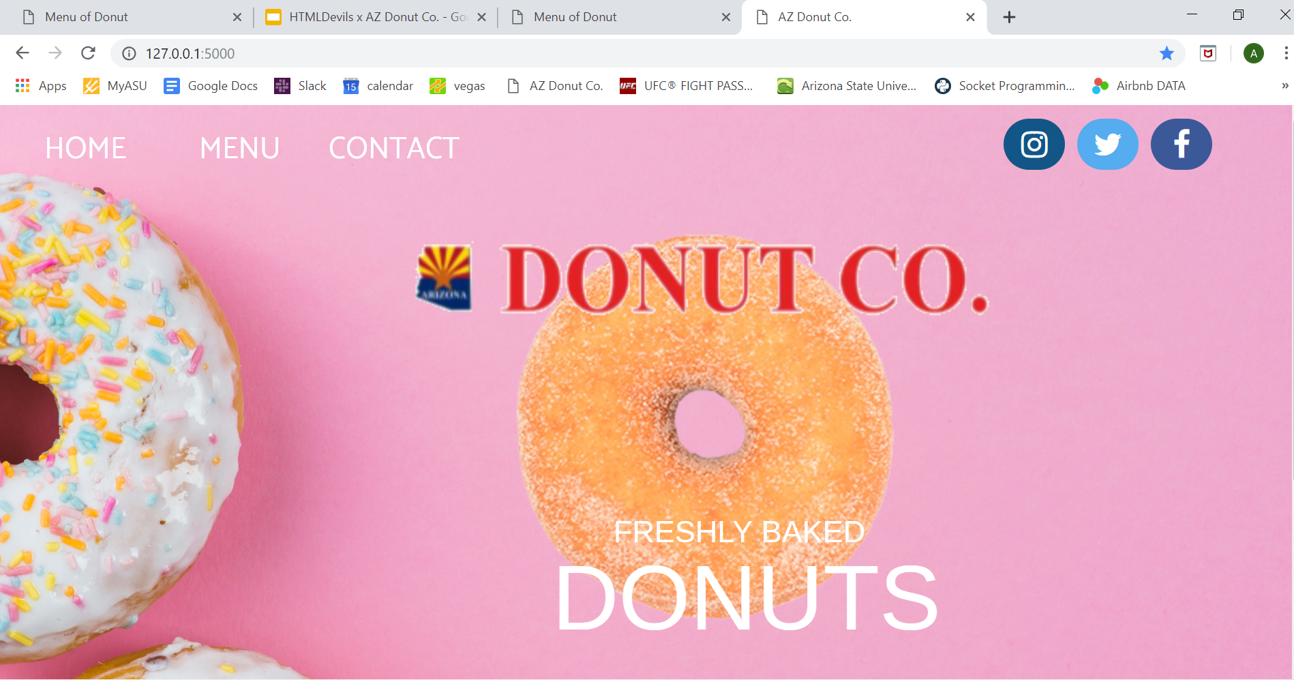
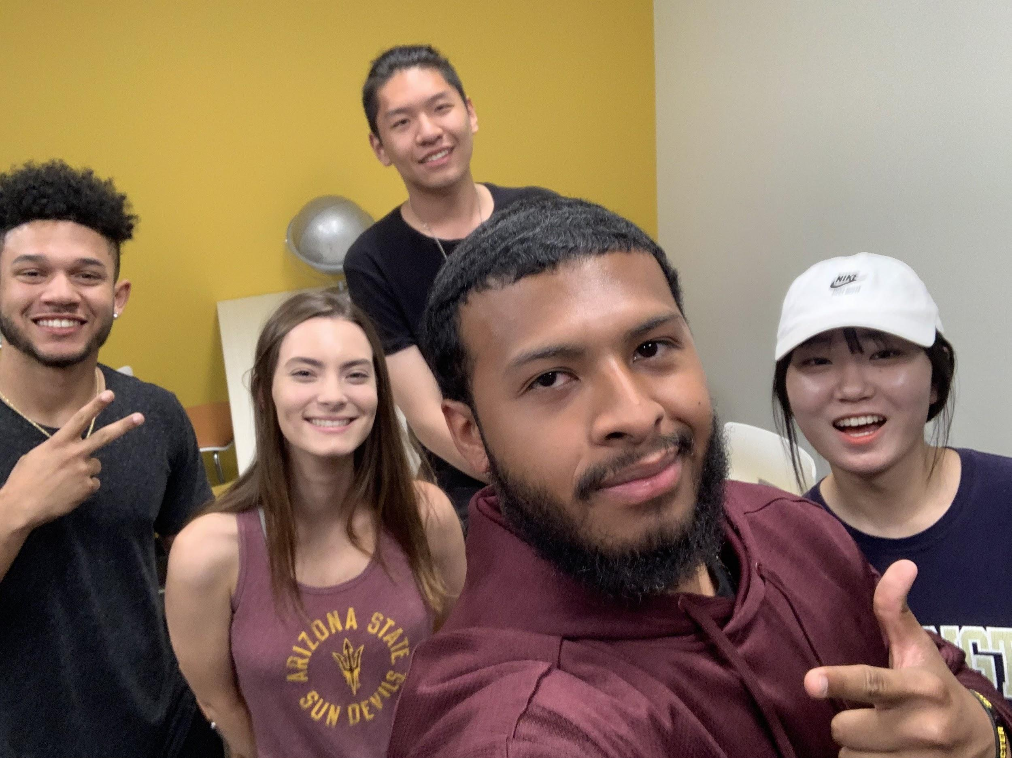
DONUT CO.
x
Freshly. Baked. Donuts.
Dalyno Puffer, Ashley Solorzano, Elijah Smith, Yuxuan Li, Haena Song

